Slide 1
Smart Farmer’s assistant: crop prediction case study
By :Mehak Suryavanshy(17BET1063)
Shreya Lingwal(17BET1053)

Slide 2
INTRODUCTION
Smart Farmer’s assistant is an farmer friendly app that helps him to choose the best suited crop in accordance to his requirements.
It has wide variety of crops .

Slide 3
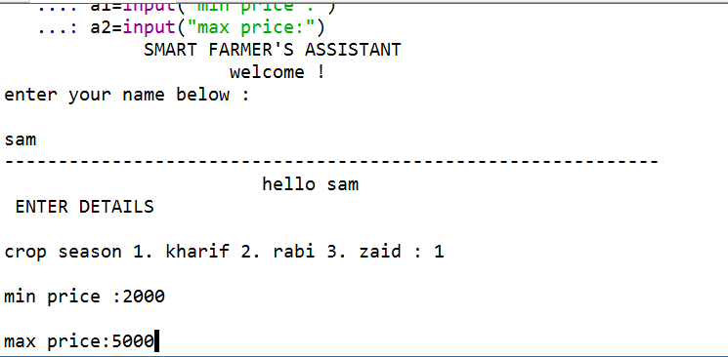
Interface

Slide 4
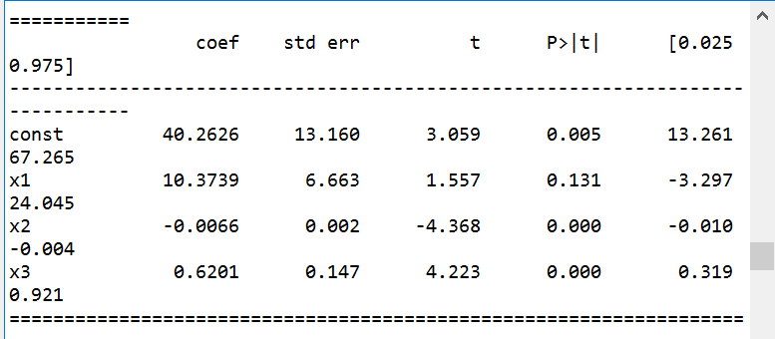
P-value of attributes

Slide 5
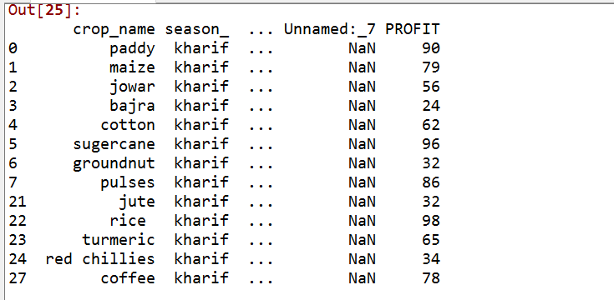
Output: all kharif season crops

Slide 6
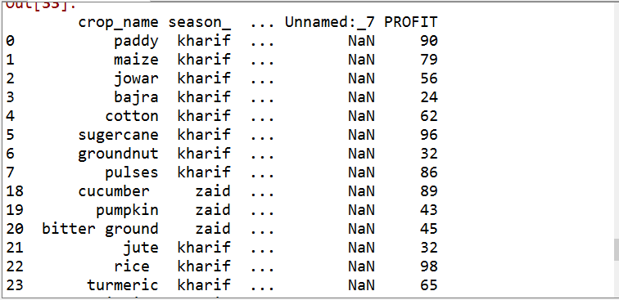
Output: crops that don’t need irrigation .

Slide 7
Overview
Agriculture is one of the flourishing revenue producing sectors of India . Today, India ranks second worldwide in farm output. Agriculture and allied sectors like forestry and fisheries accounted for 16.6% of the GDP 2018, about 50% of the total workforce.
Within the budget , fulfilling the requirements of farmers and keeping all the constraints this model provides the best crop solution. Farmers needs to switch onto this smart farming crop prediction.

Slide 8
Thank you

